Slide 1



Real Time Bangla Number Plate Recognition using Computer Vision and Convolutional Neural Network
Md. Naimul Islam Suvon
Department of Electrical and Computer Engineering
North South University
Dhaka, Bangladesh
Mehebuba Ferdous
Department of Electrical and Computer Engineering
North South University
Dhaka, Bangladesh
Riasat Khan
Department of Electrical and Computer Engineering
North South University
Dhaka, Bangladesh

Slide 2
Real Time Bangla Number Plate Recognition using Computer Vision and Convolutional Neural Network
Outline
Introduction
Motivation & Objectives
Proposed System Block Diagram
Hardware System
Number Plate Detection
Computer Vision approach
Convolutional Neural Network approach
Character Recognition
Optical Character Recognition (OCR) approach
Convolutional Neural Network approach
Performance Evaluation
Conclusion & Future work

Slide 3
Introduction & Motivation
Automatic number plate identification in today's world plays a vital role.
In 2019, there were total 497,374,000 units registered car in Bangladesh.
During entry and exit form a parking lot takes a lot of time in Bangladesh.
Our motivation is to eliminate this hassle.

Slide 4
Proposed System Block diagram
Start
Hardware Connection
Image Acquisition
Number Plate Detection
Store in Database
Character Recognition
Number Plate Extraction

Slide 5
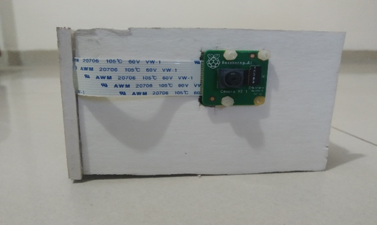
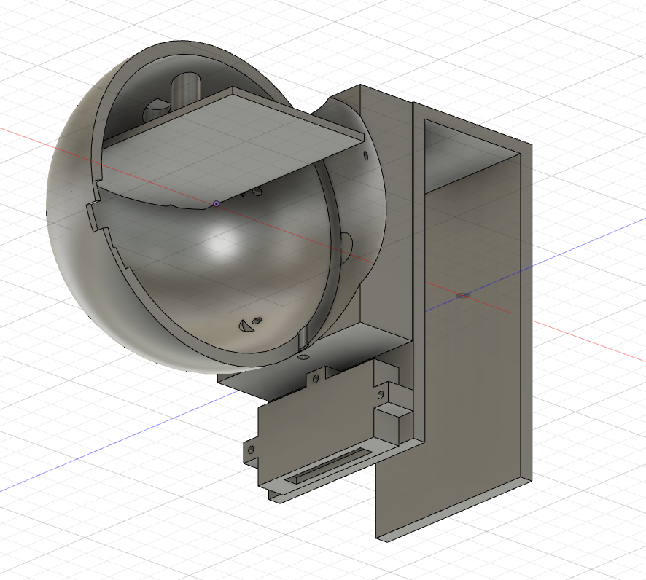
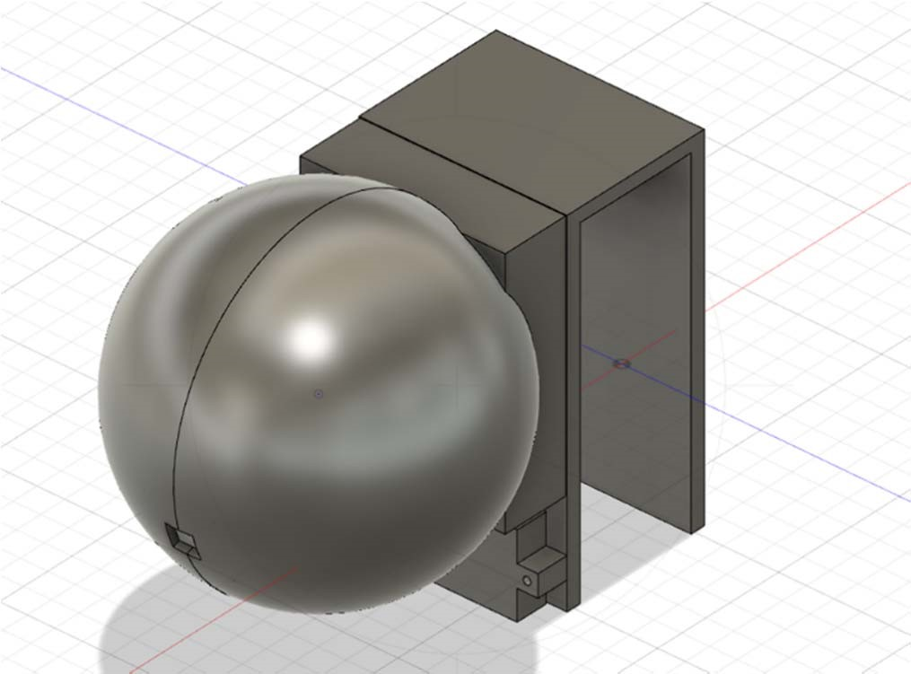
Hardware System
(a) Initial hardware system
(b) 3D inside view of our hardware system
(c) 3D outside view of our hardware system

Slide 6
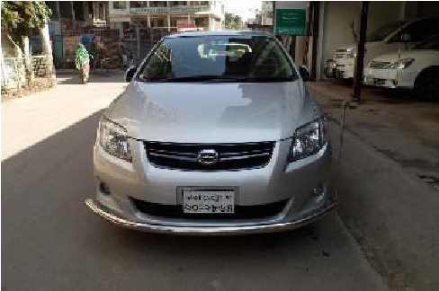
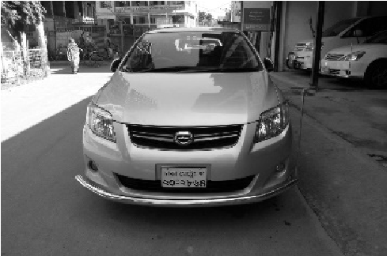
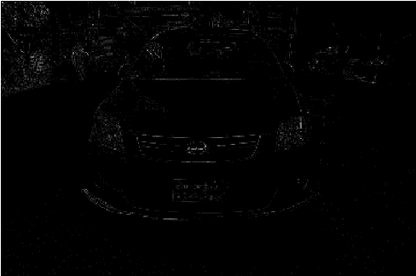
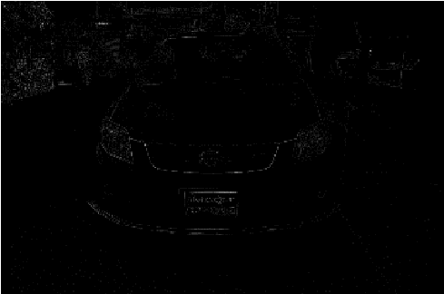

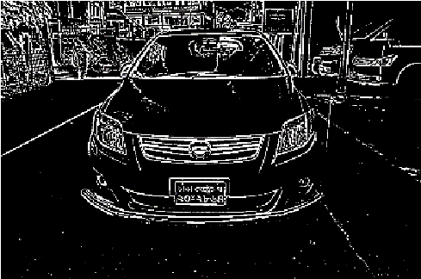
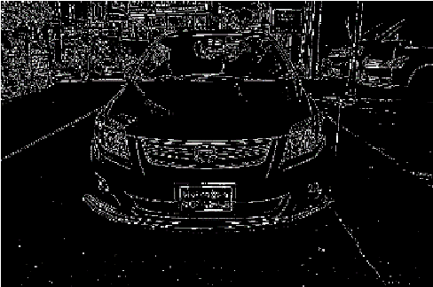
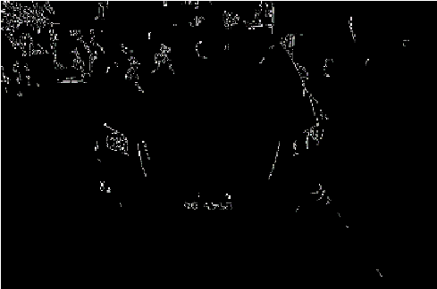

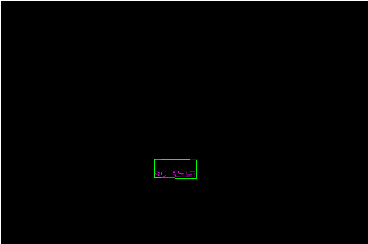
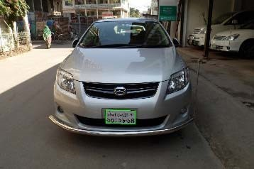
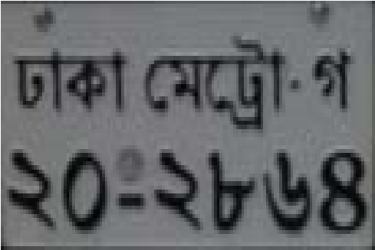
Number Plate Detection
Computer Vision approach
(1)
(2)
(3)
(4)
(5)
(6)
(7)
(8)
(9)
(10)
(11)
(12)

Slide 7
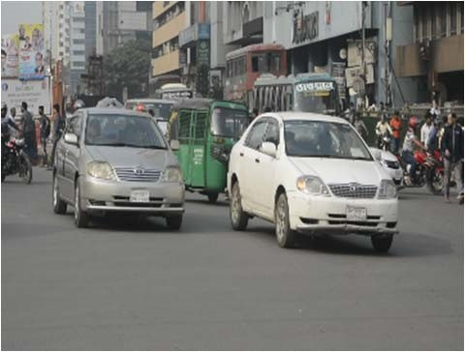
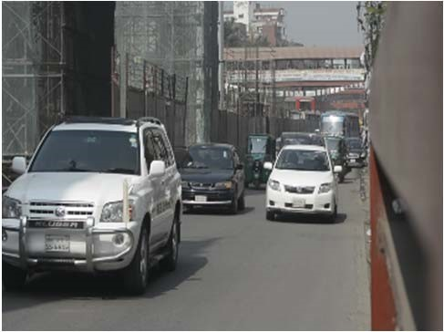
Number Plate Detection
Convolutional Neural Network approach
Unique dataset contains 2000 images captured in different environment.
You only look once version 3 (YOLOv3).
LablImg tool for number plate labelling.
Customized YOLOv3 before training to make it suitable in detecting number plate.

Slide 8
Character Recognition
Optical Character Recognition approach
Tesseract optical character recognition.
Tesseract training data.
Long-short term memory (LSTM) Training.

Slide 9
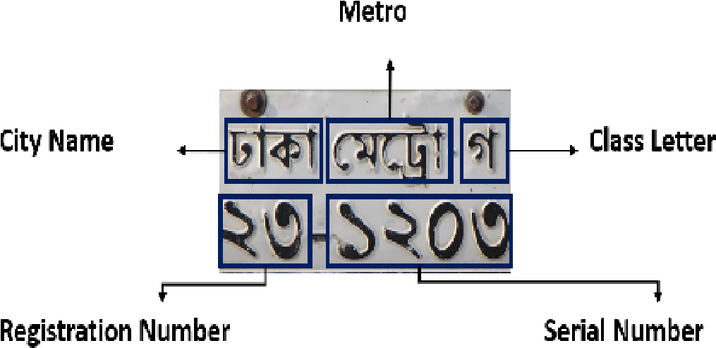


Character Recognition
Convolutional Neural Network approach
Two line format number plate.
Segment the Number plate into five sector.
Sliced the words , characters and numbers.
Create 18 different class.
Notes:
The plates of Bangladesh have a 2-line format compared to the 1 line format of other countries.

Slide 10
Character Recognition
Convolutional Neural Network Layers and Trainable Parameters
Layer | Layer of operation | Number of feature maps | Feature maps size | Window size | Parameters
C1 | Convolution | 6 | 28 X 28 | 5 X 5 | 156
S1 | MaxPooling | 6 | 14 X 14 | 2 X 2 | 0
C2 | Convolution | 16 | 10 X 10 | 5 X 5 | 2,496
S2 | MaxPooling | 16 | 5 X 5 | 2 X 2 | 0
F1 | Fully Connected | 400 | 1 X1 | N/A | 166,400
F2 | Fully Connected | 18 | 1 X 1 | N/A | 7,218
1,76,270

Slide 11
Result & Analysis
Number Plate Detection
91% accuracy in Computer vision approach.
Limitations of Computer vision.
For CNN moving average loss is 0.09 in the validation with IoU >85%.
95% detection accuracy with CNN.

Slide 12
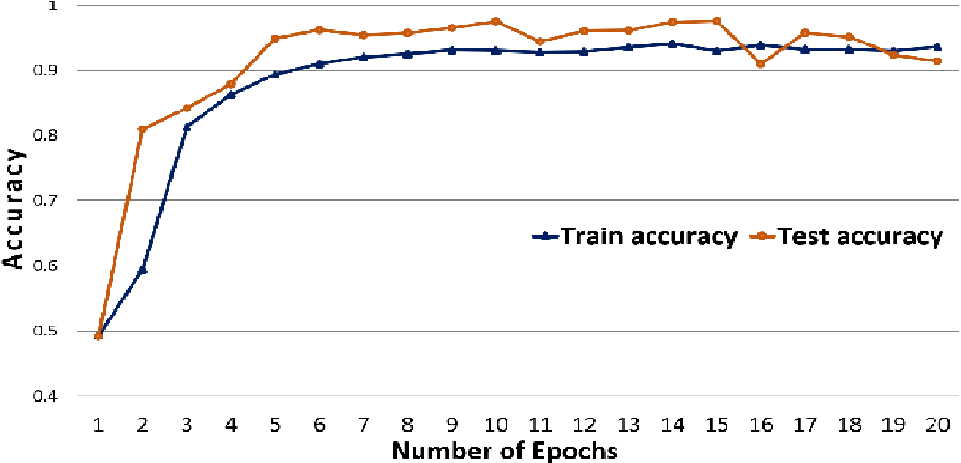
Result & Analysis
Character Recognition
Tesseract OCR have a 90% testing accuracy
CNN model performs better
Accuracy vs Epoch of CNN model

Slide 13
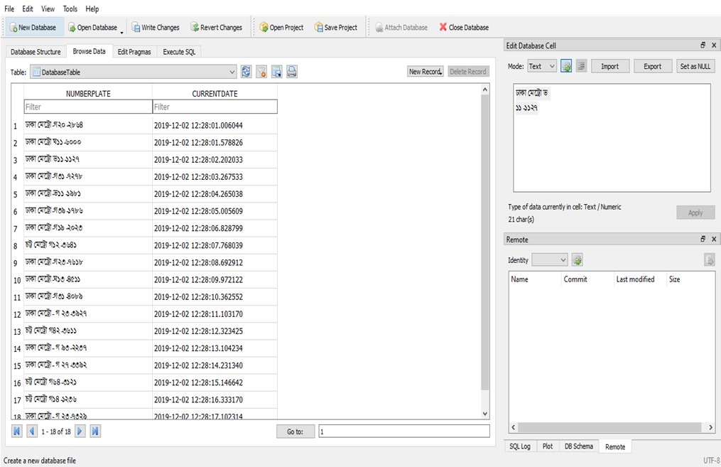
Result & Analysis
Fig.4. MySQL database of recognized number plates

Slide 14
Conclusion & Future Work
New scope of the market.
Stolen car Tracking.
App-based Intelligent parking system with a 3D view of parking garage.
Traffic violation tracking system.

Slide 15
THANK YOU

